Slide 1

Fire Watch - Update
Using Convolutional Neural Networks to Prevent Wildfires
Carter Elliott & Steven Nguyen in Partnership with Perimeter Platform

Slide 2
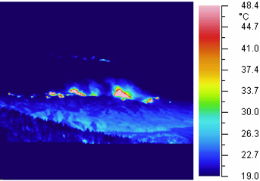
A Quick Refresher...
Wildfires have become more intense and lasted longer due to climate change
Major environmental, financial, and social impacts
California has been hit especially hard
A prototype fire sensor has been created, but is extremely limited in its capabilities
Can take and send images, but cannot tell what’s a fire and what is not
Convolutional Neural Networks (CNN) can be used to classify fires, which can be used to detect and alert others about small fires before the become infernos
Using the FLIR Thermal Image Dataset to train the model (or ARE we…?)

Slide 3

Machine Learning Checklist
Frame the problem and look at the big picture
Get the data
Explore the data to gain insights
Prepare the data to better expose underlying patterns to ML algorithms
Explore many different models and short list the best ones
Fine tune models and combine to make great solution
Present the solution
Launch, monitor, and maintain the system

Slide 4
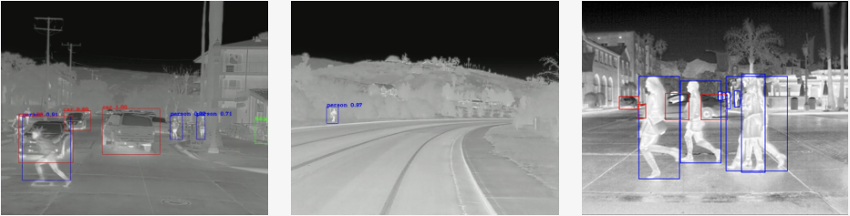
So...About the FLIR Dataset...
We could not use that dataset for multiple reasons:
Formatting of the dataset was incompatible (multiple .zip files)
Size of dataset was too large for our needs
Using the FLIR dataset would not help us achieve our main goal
Combining thermal images of fires with FLIR dataset would over complicate the project
Only a small fraction of the images would be of fires (EXTREME imbalance)

Slide 5
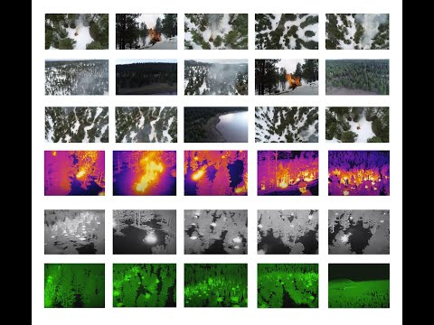
The FLAME Dataset
Fire Luminosity Airborne-based Machine learning Evaluation Dataset
Created for research purposes
Data comes from a controlled burn in Northern Arizona
Consists of regular images + video, thermal videos
Camera used: FLIR Vue Pro R Thermal Image Camera
Uploaded on April 16, 2021
Recent Data
Publicly available for use
https://ieee-dataport.org/open-access/flame-dataset-aerial-imagery-pile-burn-detection-using-drones-uavs

Slide 6
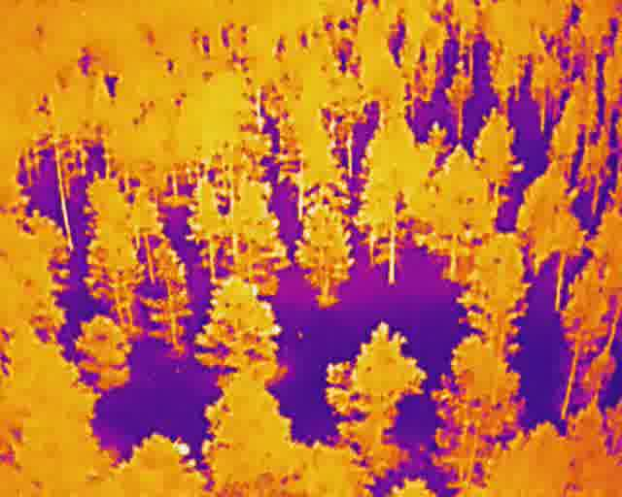
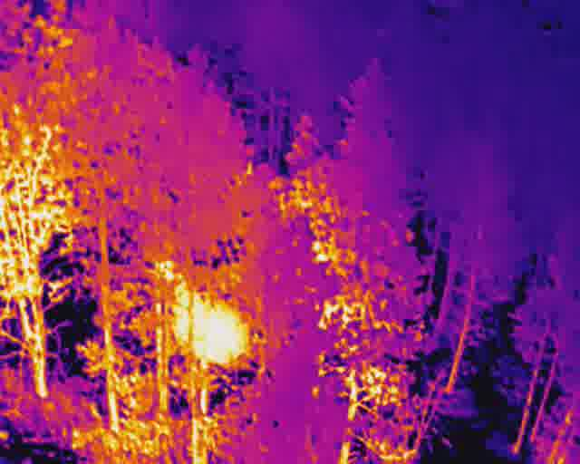
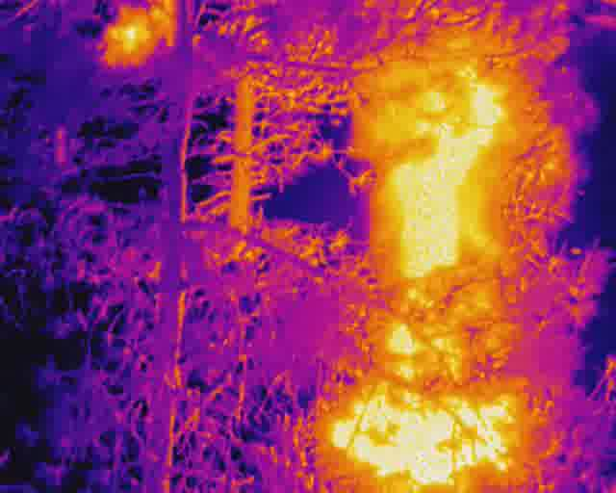
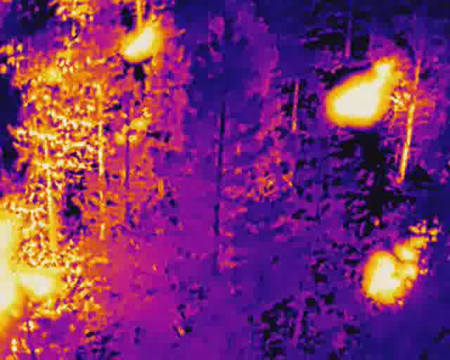
Modifying The Dataset
Our dataset consisted of thermal images extracted from a thermal video
Used “VideoProc Converter” software to extract images
Dataset consists of 3,396 images with 4 classes:
‘no_fire’, ‘small_fire’, ‘large_fire’, ‘multiple_fires’
Images are still in color - need to be grayscale to work with sensor
no_fire
small_fire
large_fire
multiple_fires

Slide 7
Colab Notebook Demonstration:
https://colab.research.google.com/drive/1IURan__-glEq4jqfuWz9o3evef9NxvDj?usp=sharing

Slide 8
Issues (11/9/21 - 11/16/21)
We could not use the FLIR Dataset because of multiple issues
Communication between us and the client has been mainly one sides
Some of the images we have are not the best (might throw off model accuracy)

Slide 9
Milestones Accomplished (11/9/21 - 11/16/21)
Opened regular channels of communication (email and text)
We have found a source for a new dataset (FLAME Dataset)
Created a small dataset from the FLAME Dataset Thermal Video
Created a base Colab Notebook that we will use to create and run our model
Successfully uploaded the dataset to our Colab Notebook
Successfully created Training and Testing Sets within the Colab Notebook
Successfully plotted the first 9 images of the dataset

Slide 10
Milestones Missed (11/9/21 - 11/16/21)
Define the parameters we want our CNN to work with (what is the threshold it needs to hit before a notification is sent out) - AT RISK
Start doing data preprocessing with the Thermal Image Dataset - AT RISK

Slide 11
Milestones Planned (11/16/21 - 11/30/21)
Figure out how to grayscale images (since this is a “batch dataset”
Complete Exploratory Data Analysis and prepare data to be fed into the model (normalize, clean, etc.)
Create different CNN with different parameters (different filter sizes, layer amounts, strides, zero padding, etc.) and document models that worked best

Slide 12
Areas/Questions for Discussion + Research
Technical Research Question (TRQ)
What is a “batch dataset”?
How do we turn our images into grayscale images (since this is a batch dataset)?
What is a “seed” and what purpose does it serve?
General Research Questions (GRQ)
How have Convolutional Neural Networks been used for firefighting in the past?
Have any Convolutional Neural Networks for firefighting been used in the real world?
What impact would this kind of technology have on the firefighting landscape?

